Slide 1
Elasticity of Demand and Supply

Slide 2
When the price of Walnut was Rs 1200/kg the demand was 16,000 kg per week in a market. As price increased to Rs 1800/kg the demand decreased to 4000 kg.
When Price of banana was Rs 3000/qtl the demand in that market was 120 qtl when the price increased to Rs 4000/qtl the demand decreased to 60 qtl.
Can we compare sensitivity of demand to prices of these two commodities?

Slide 3
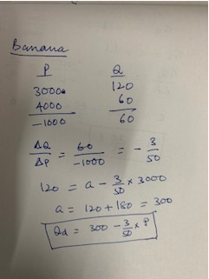

Slide 4
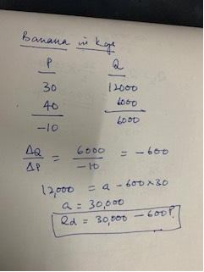

Slide 5
Unit-free Measure of Responsiveness
(%ΔQ/% ΔP) = (ΔQ/Q)/(ΔP/P)
Ep =(ΔQ/ ΔP).(P/Q)
Elasticity is a measure of the responsiveness of one variable to changes in another variable.
Elasticity is a percentage relationship: percentage change in one variable resulting from one percent change in the other
Price Elasticity of Demand: Percentage change in the quantity demanded of a good resulting from a one percent change in price
Coefficient of Elasticity = Percentage change in A/ Percentage change in B

Slide 6
Demand Function for Good X
Q_{X} = a₀ - a₁P_{X} + a₂N + a₃I + a₄P_{Y} + a₅T
Q_{X} = 160 - 10P_{X} + 2N + 0.5I + 2P_{Y} + T
Demand Curve for Good X
Given N = 58, I = 36, P_{Y} = 12, T = 112
Q = 430 - 10P

Slide 7
Linear Demand Function
Q_{X} = a₀ + a₁P_{X} + a₂N + a₃I + a₄P_{Y} + a₅T
P_{X}
Intercept:
a₀ + a₂N + a₃I + a₄P_{Y} + a₅T
Slope:
ΔQ_{X}/ΔP_{X} = a₁
Q_{X}

Slide 8
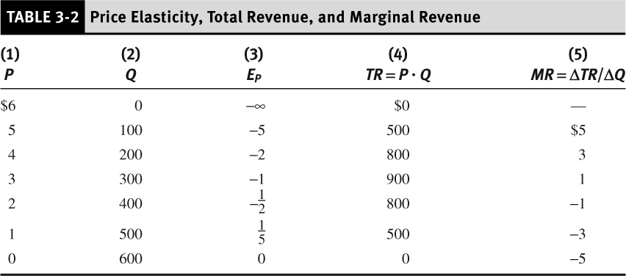
-

Slide 9
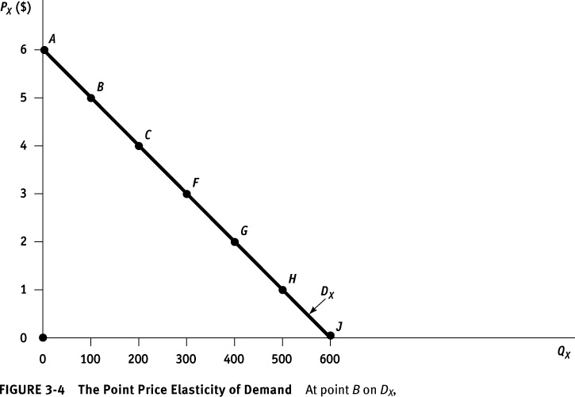

Slide 10
-

Slide 11
Linear Demand Function Example 2
Q = 600 – 100P
Inverse Demand Curve
P = 6 – 0.01Q
Total and Marginal Revenue Functions
TR = 6Q – 0.01Q²
MR = 6 – 0.02Q

Slide 12
Extent of Elasticity
Inelastic Demand: Elasticity less than one. Percentage change in consumers purchase quantity is less than percentage change in price.
Completely Inelastic Demand (Perfect Inelasticity): Consumer will buy a fixed quantity of a good regardless of the price
Elastic Demand: Elasticity greater than one. Percentage change in consumers purchase quantity is more than percentage change in price.
Infinitely Elastic Demand (Perfect elasticity): Consumers buy as much of good as they can get at a single price, but for any higher price the quantity demanded drops to zero
Unitary Elastic: Elasticity equal to one. Percentage change in consumers purchase quantity equal to percentage change in price

Slide 13
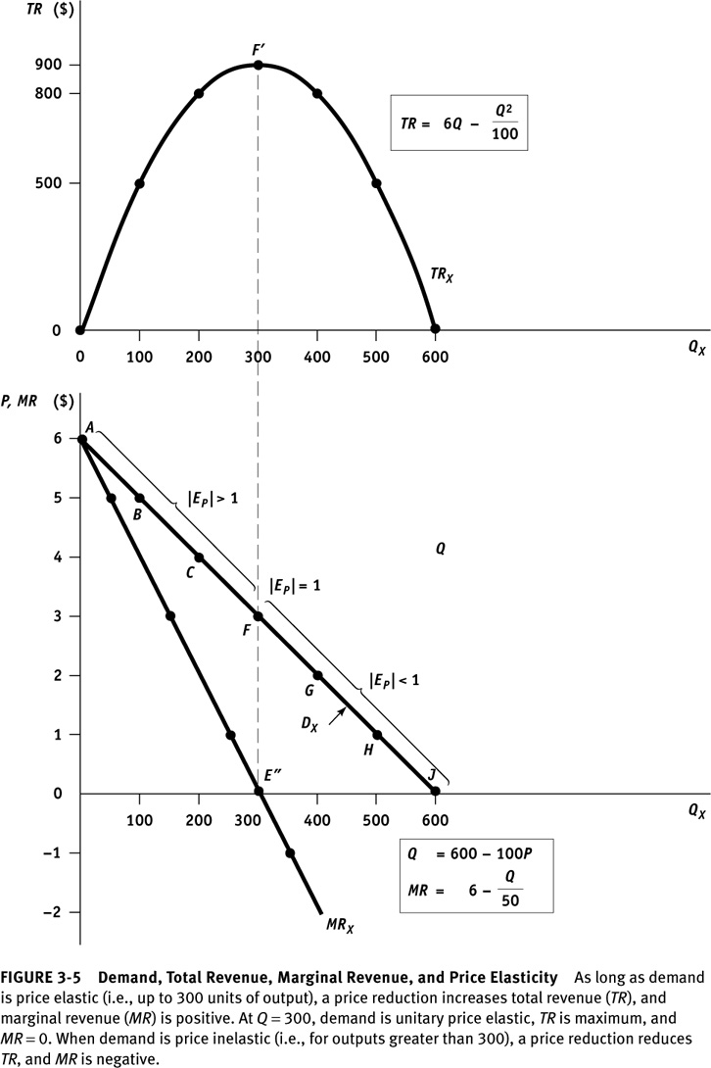

Slide 14
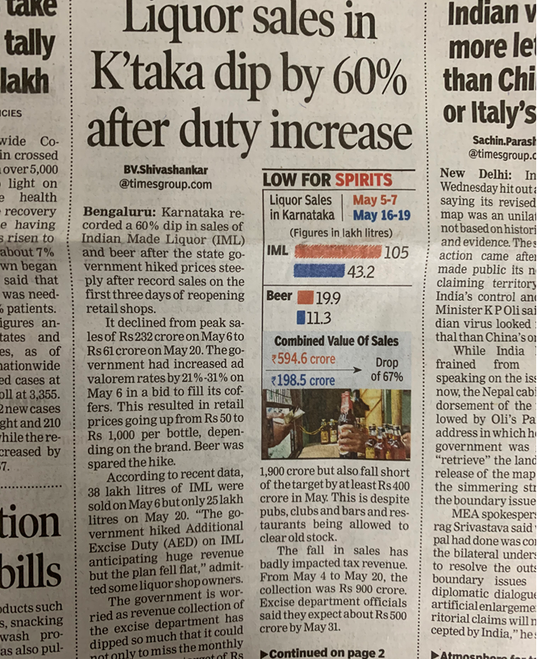
Revenue and Ep

Slide 15
Revenue and Ep
Elasticity | Effect of Price Increase on Revenue | Effect of Price Decrease on Revenue
│Ep│<1 Relative InElasticity | Revenue Increases | Revenue Decreases
│Ep│=1 Unitary elasticity | No Change in Revenue | No Change in Revenue
│EP│>1 Relative Elasticity | Revenue decreases | Revenue increases

Slide 16
Total Revenue Test
If the demand is elastic, an increase (decrease) in price will lead to a decrease (increase) in total revenue.
If demand is inelastic, an increase (decrease) in price will lead to an increase (decrease) in total revenue.
Finally, total revenue is maximized at the point where demand is unitary elastic.
Managerial decision: whether to cut in price?

Slide 17
Demand Curve Faced by a Firm Depends on Market Structure
Market demand curve
Imperfect competition
  Firm’s demand curve has a negative slope
  Monopoly - same as market demand
  Oligopoly
  Monopolistic Competition
Perfect Competition
  Firm is a price taker
  Firm’s demand curve is horizontal

Slide 18
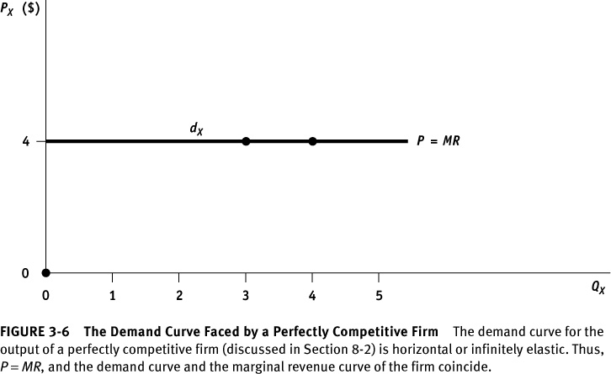

Slide 19
Price Elasticity of Demand
Q_{X} = a₀ + a₁P_{X} + a₂N + a₃I + a₄P_{Y} + a₅T
Point Definition
Linear Function

Slide 20
Price Elasticity of Demand
Arc Definition

Slide 21
Determinants of Price Elasticity of Demand
The demand for a commodity will be more price elastic if:
It has more close substitutes
Proportion of total expenditure
Durability of the product
  Possibility of postponing purchase
  Possibility of repair
More time is available for buyers to adjust to a price change

Slide 22
Demand Curve Faced by a Firm Depends on the Type of Product
Durable Goods
  Provide a stream of services over time
  Demand is volatile
Nondurable Goods and Services
Producers’ Goods
  Used in the production of other goods
  Demand is derived from demand for final goods or services

Slide 23
Derived Demand Curve will be more inelastic
The more essential is the component
The inelastic is the demand curve for the final product
The smaller is the fraction of total cost going to this component
The more inelastic is the supply curve of cooperating factors

Slide 24
Income Elasticity of Demand
Q_{X} = a₀ - a₁P_{X} + a₂N + a₃I + a₄P_{Y} + a₅T
Point Definition
Linear Function

Slide 25
Income Elasticity of Demand
Arc Definition
Normal Good
Inferior Good

Slide 27
Short Run versus Long Run Elasticities
Demand
  Price
    Non-durables: long run price elasticity is more than the short run
    Durables: long run price elasticity is less than the short run
  Income
    For most goods:long run income elasticity is larger than the short run
    Durables: long run income elasticity is less than the short run
      Cyclical industries: Sales tend to magnify cyclical changes in gross domestic products and national income.

Slide 28
Petrol
  Ep = -0.11 -0.22 –0.32 –0.49 –0.82 –1.17
  EI = 0.07 0.13 0.20 0.32 0.54 0.78
Automobile
  EP = -1.20 -0.93 -0.75 -0.55 -0.42 0.40
  EI = 3.2 2.33 1.88 1.38 1.02 1.00

Slide 29
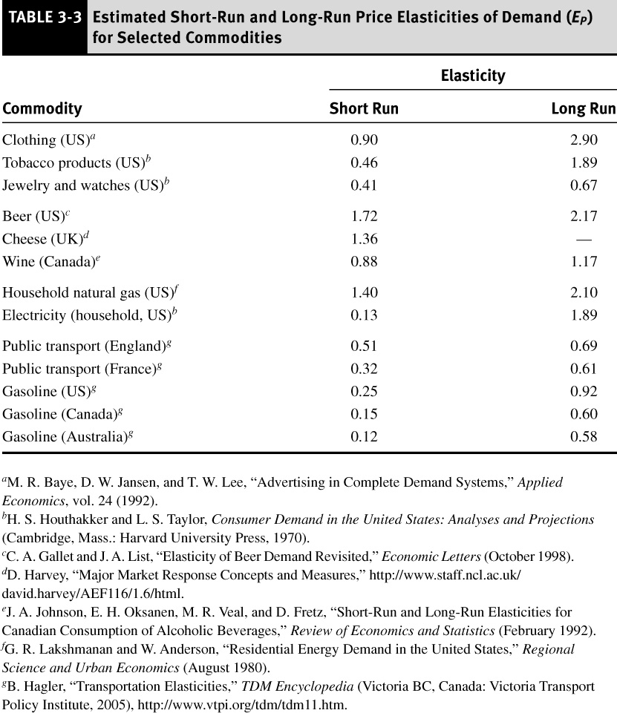

Slide 30
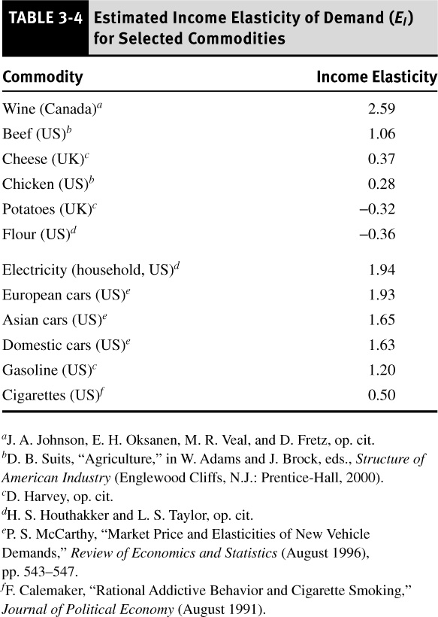

Slide 31
Cross-Price Elasticity of Demand
Q_{X} = a₀ - a₁P_{X} + a₂N + a₃I + a₄P_{Y} + a₅T
Point Definition
Linear Function

Slide 32
Cross-Price Elasticity of Demand
Arc Definition
Substitutes
Complements

Slide 33
Problems
Supply of Gas Q= 140+ 4 Pg + 0.5 Po
Demand for Gas Q= -4 Pg + 15 Po
Po is Rs 40
Cross Price elasticity at equilibrium?

Slide 34
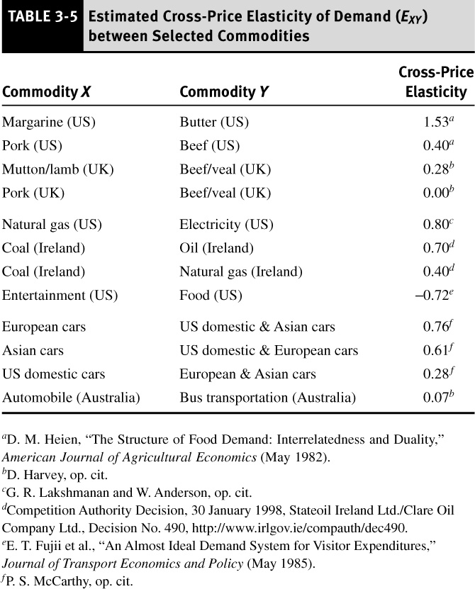

Slide 35
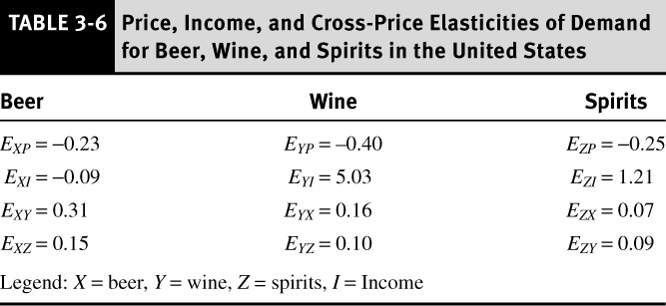

Slide 36
Cross Price Elasticities
 | Raspuri | Mallika | Alphonso
Raspuri | -3.07 | 1.56 | 0.01
Mallika | 1.16 | -3.01 | 0.14
Alphonso | 0.18 | 0.09 | -2.76

Slide 37
Advertising Elasticity : Percentage change in quantity relative to 1 percent change in advertising expenses.
Elasticity with respect to interest rates

Slide 38
The ABC company manufactures AM/FM radios and sells on average 3000 units monthly at Rs 2500 to retail stores. Its closest competitor produces a similar types of radio that sells for Rs 2800.
If the demand for ABC’s product has an elasticity coefficient of -3, how much will it sell per month if the price is lowered to Rs 2200.
If the competitor decreases price to 2400 and the cross price elasticity is .3, what will ABC’s monthly sales be?

Slide 39
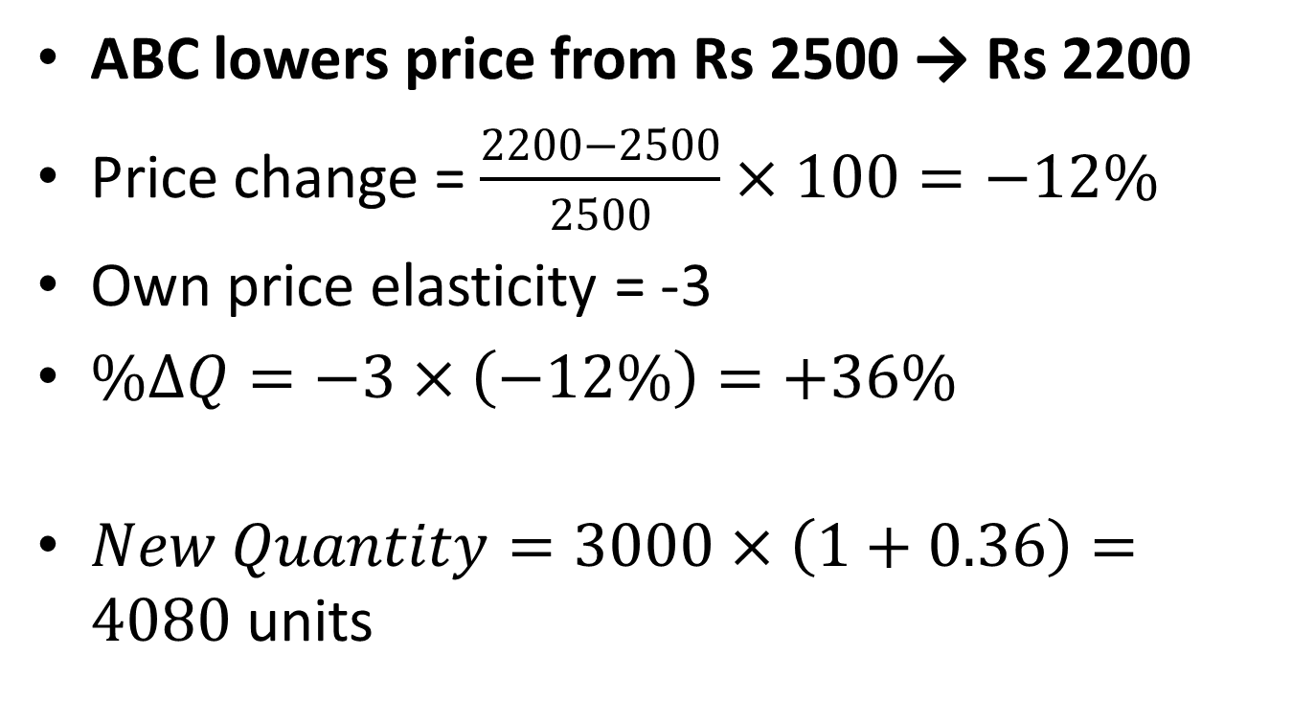
ABC lowers price from Rs 2500 → Rs 2200
Price change = $\frac{2200−2500}{2500}×100=−12\%$
Own price elasticity = -3
$\%ΔQ=−3×\left(−12\%\right)=+36\%$
$New Quantity=3000×\left(1+0.36\right)=4080\text{ units}$

Slide 40
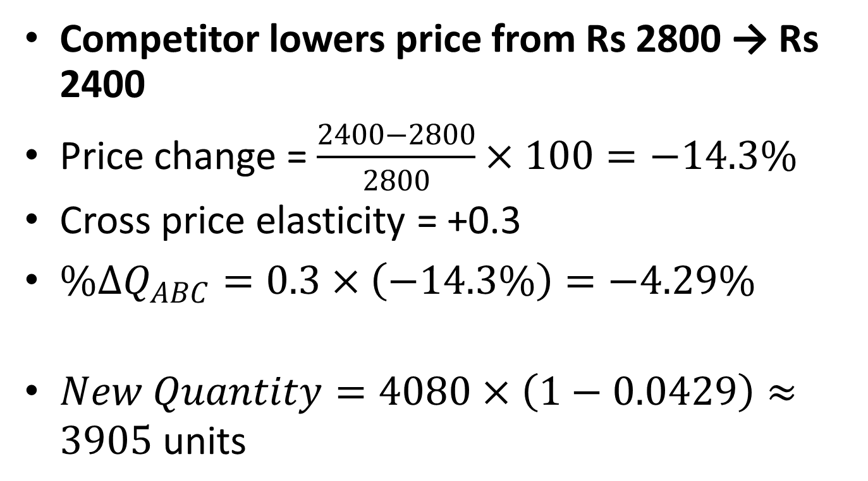
Competitor lowers price from Rs 2800 → Rs 2400
Price change = $\frac{2400−2800}{2800}×100=−14.3\%$
Cross price elasticity = +0.3
$\%ΔQ_{ABC}=0.3×\left(−14.3\%\right)=−4.29\%$
$New Quantity=4080×\left(1−0.0429\right)≈3905\text{ units}$

Slide 41
Supply elasticity
Price Elasticity of Supply: Percentage change in quantity supplied resulting from a one percent increase in price
Point Elasticity of Demand: Price elasticity at a particular point on the demand curve
Arc Elasticity of Demand: Price elasticity calculated over a range of prices

Slide 42
Price Elasticity of Supply of durables
 | SR | LR
Primary Supply | 0.2 | 1.60
Secondary Supply | 0.48 | 0.31
Total | 0.25 | 1.50

Slide 43
Supply
  For most products long-run supply is much more price elastic than short run supply – capacity constraints
  For durables supply is more elastic in the short- run – recycling; secondary supply

Slide 44
Computer Use in India
25% growth between (2001/2 to 2006/7)
But penetration (per thousand population) in India is low
  India 23
  China 79
  Brazil 139
  Russia 153
Taxes 20.36%. In many other countries taxes are removed
Notes:
44

Slide 45
Notes:
45

Slide 46
Notes:
46

Slide 47
D = 10.98 – 0.11 P + 0.02 PCI
D=Demand for personal computers (in ‘00000)
P= Price of personal computer (in $)
PCI = Per capita income ($/year)
Current level: PCI=400
D = 18.98 – 0.11 P

Slide 48
Regression Results (log form)
Desktop
Log Q_{d} = 8.20 – 1. 40 Log DP_{d} + 0.35 Log DPCY
(3.24) (-5.66) (2.86)
R-Square = 0.89
Notebook
Log Q_{n} = -12.96 –1.14 Log DP_{n} + 2.52 Log DPCY (-2.09) (-3.24) (5.51)
R-square =.924
Notes:
48

